Slide 1


Building A Front End For: Cryptocurrency Price Predictions Via LSTM Networks (Keras ML)
Folake Adeshina
James Burns
Gabe Mansur
Raul Pulido
Rachel Wallace
CSCI E-71 Agile Software Development
Fall 2021
Harvard DCE: Extension School

Slide 2
Introduction via Questions
What is cryptocurrency?
What are cryptocurrency prices based on?
What deep learning methods will be used to explore price fundamentals?
Does your model work?

Slide 3
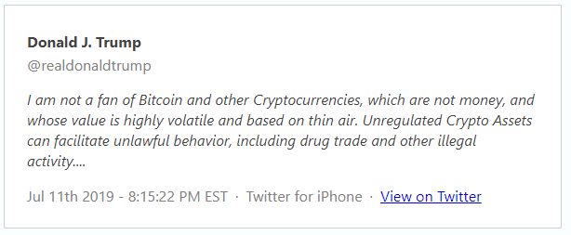
Problem Statement: Prices Based on Thin Air?
https://www.thetrumparchive.com/?searchbox=%22thin+air%22

Slide 4

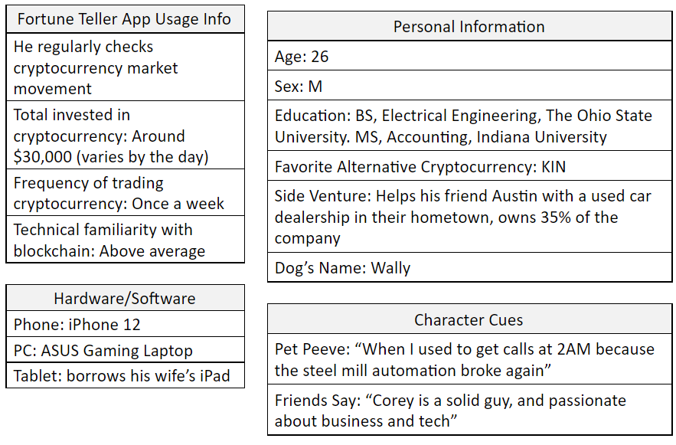
User Persona, Stakeholder

Slide 5

What is Cryptocurrency?
https://www.vectorstock.com/royalty-free-vector/cryptocurrency-infographic-10-steps-concept-vector-27840819

Slide 6
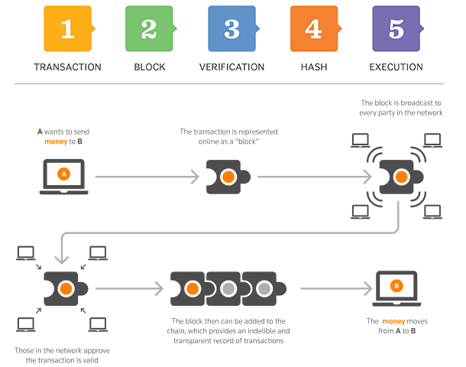
Blockchain Technology?
https://www.garyfox.co/how-blockchain-works-infographic/

Slide 7

Why Create Cryptocurrency?
https://bitcoin.org/bitcoin.pdf

Slide 8
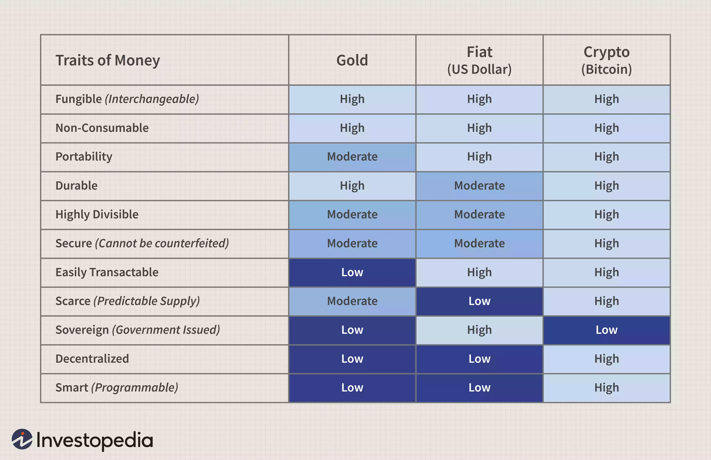
Worth of Cryptocurrency?
Image by Sabrina Jiang © Investopedia 2020

Slide 9
What Data Predicts Price?
Hashrate
Active Accounts
According to Bhambwhani et al. (2019)

Slide 10
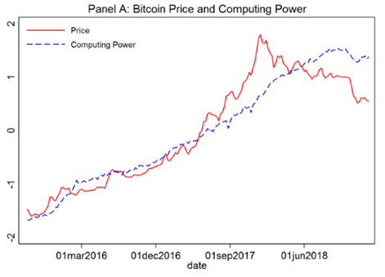
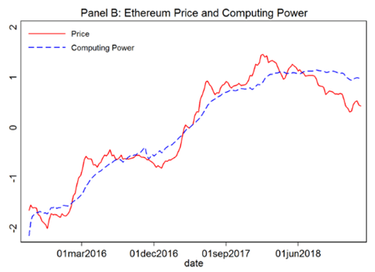
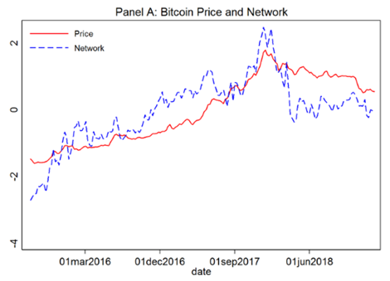
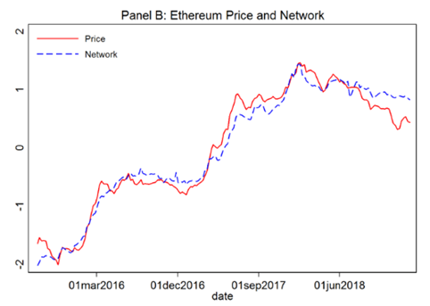
Hashrate & Active Accounts?
Bhambwhani et al. (2019)

Slide 11
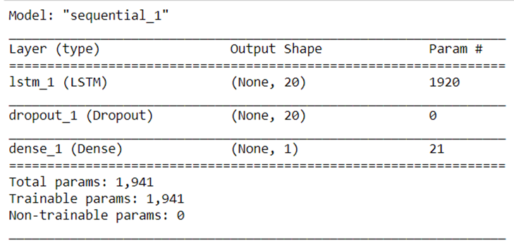
Methodology: LSTM Network

Slide 12
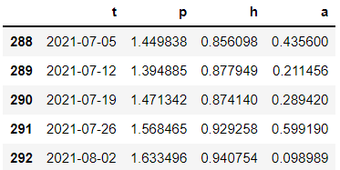
Data Inputs
#Convert data into 3d array of
# shape (observations over time, n_timesteps, n_vars)
n_timesteps = 8
features_set_price = []
labels_price = []
for i in range(n_timesteps, xt.shape[0]):
features_set_price.append(xt[i-n_timesteps:i,1]) #prices
labels_price.append(xt[i,1])
features_set_hash = []
labels_hash = []
for i in range(n_timesteps, xt.shape[0]):
features_set_hash.append(xt[i-n_timesteps:i,2])
labels_hash.append(xt[i,2])
features_set_accounts = []
labels_accounts = []
for i in range(n_timesteps, xt.shape[0]):
features_set_accounts.append(xt[i-n_timesteps:i,3])
labels_accounts.append(xt[i,3])

Slide 13
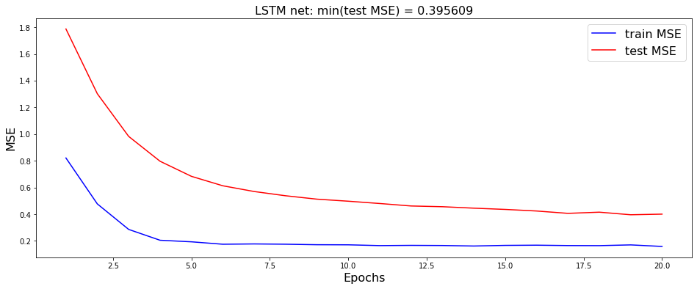
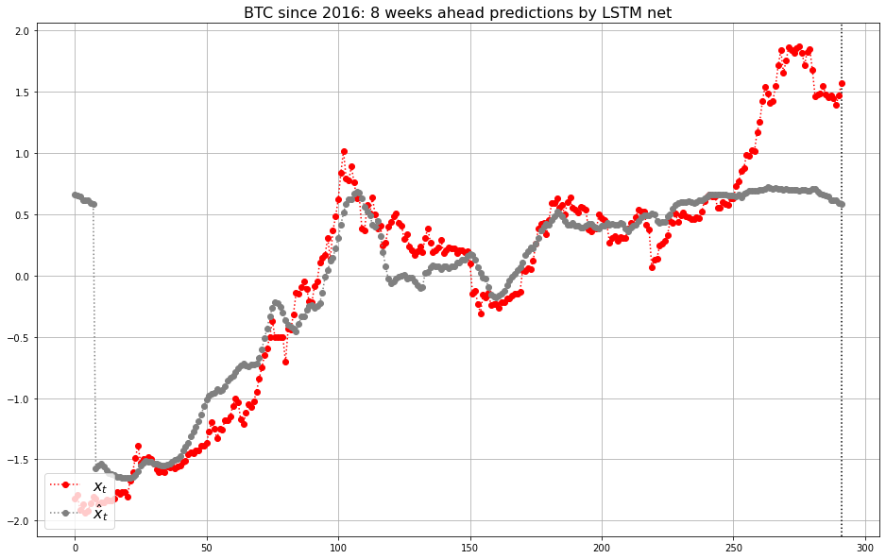
Model 1: Bitcoin Baseline
Good models are evaluated based on graphical evidence. A gray prediction line that precedes the red actual line is the goal.

Slide 14
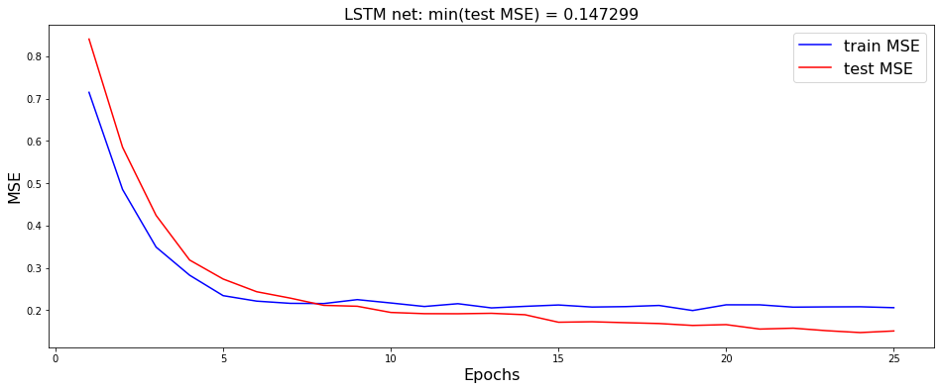
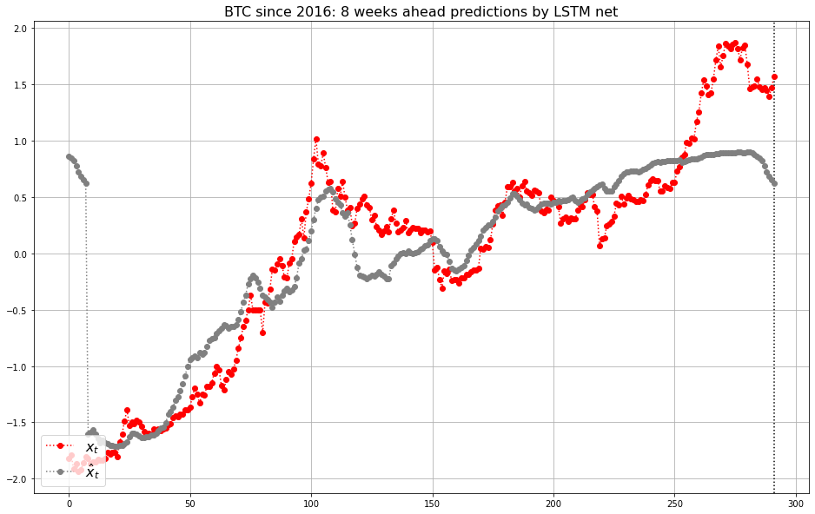
Model 2: Bitcoin Improved

Slide 15
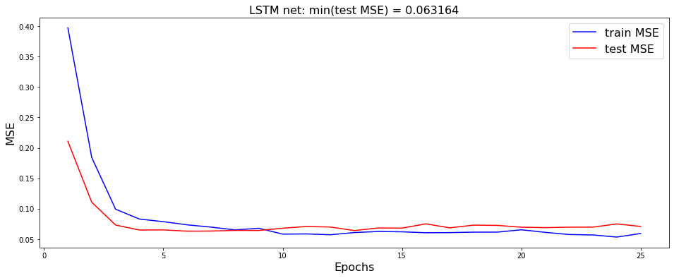
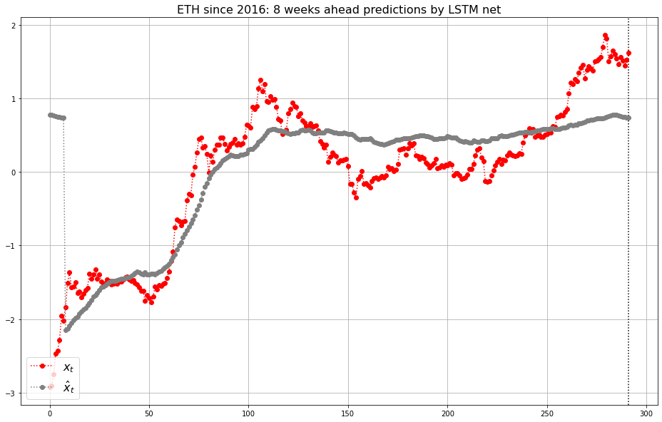
Model 3: Baseline Ethereum

Slide 16
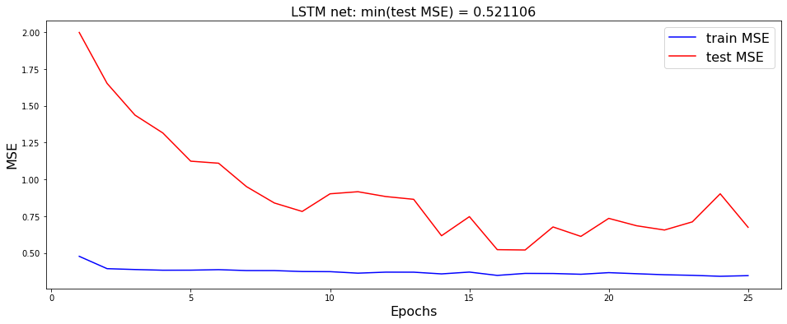
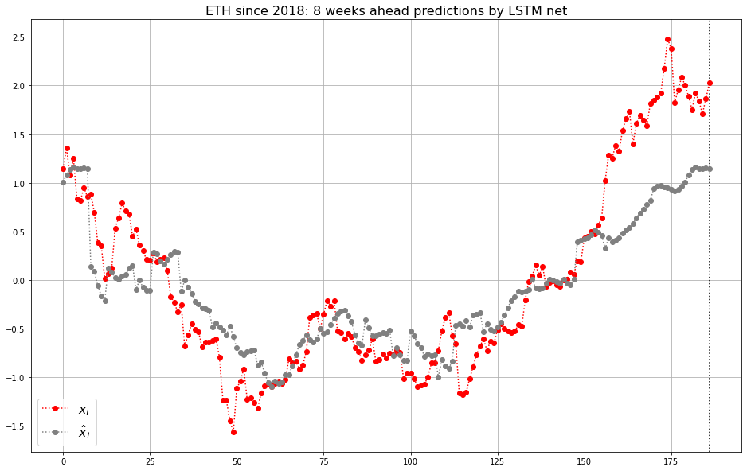
Model 4: Ethereum Since 2018

Slide 17
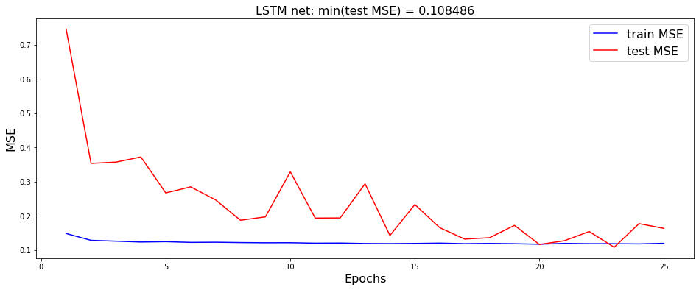
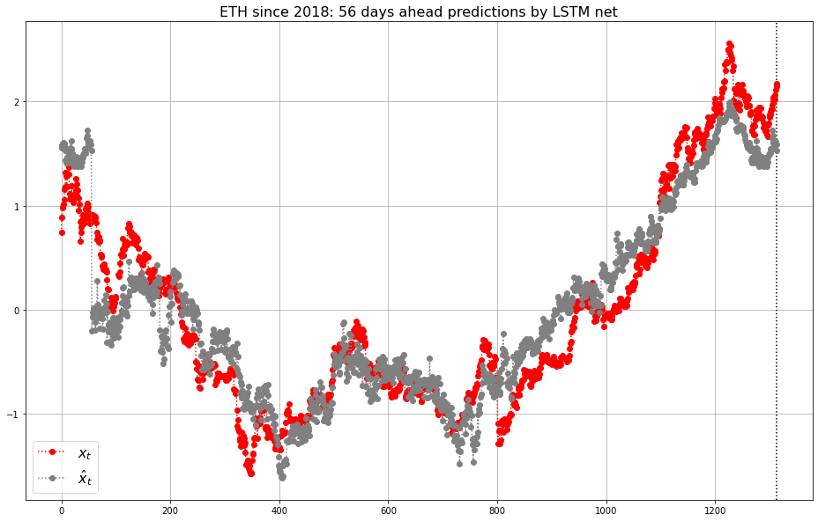
Model 5: Ethereum Daily

Slide 18
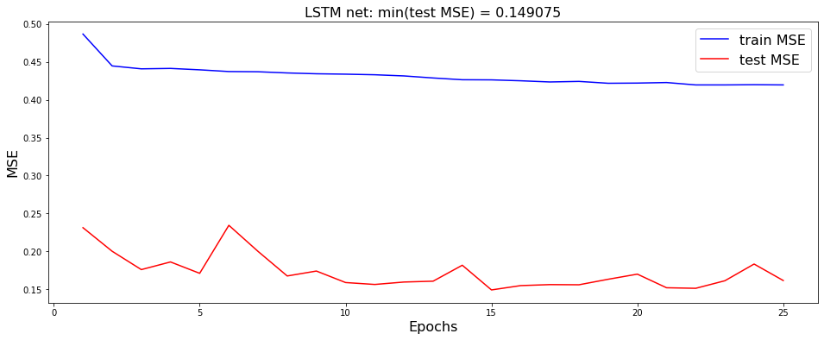
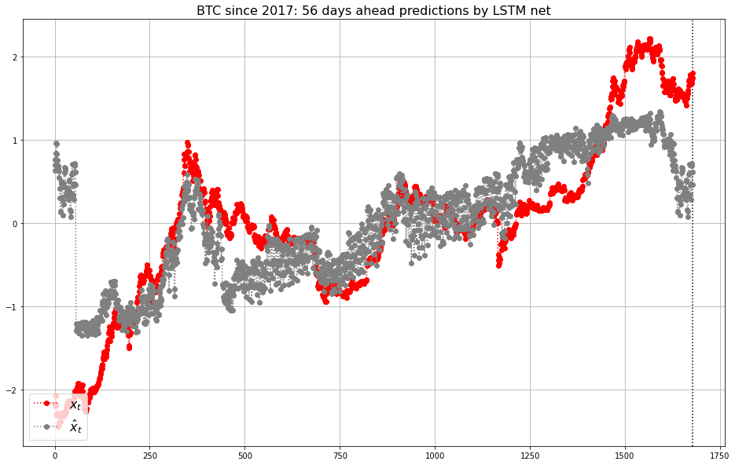
Model 6: Improved Bitcoin Daily Since 2017

Slide 19
Weaknesses
The models are currently only evaluated based on MSE and subjective graphical evidence.
The models do not adjust sufficiently for the asset inflationary pressures experienced during the current COVID event
The relationships between the hashrate and active accounts factors vary substantially in Ethereum versus Bitcoin. More predictors would be necessary to build a strong Ethereum predictive value model.
The model relies on hashrate, from Proof-of-work, which is an increasingly less popular security method. Some measure of Proof-of-stake blockchain data will have to replace this metric in the future for Ethereum.

Slide 20
Strengths
The models predict the price movement of Bitcoin well, and with the inflation proxy input adjustment, could be used to evaluate current valuations.
The models run very quickly and easily for a variety of timeframes and assets
The graphical output allows for quick evaluation of the quality of predictions, given those inputs and timeframe
This model seeks to predict what a cryptocurrency should be worth. There are no alternatives available publicly. This is cutting edge finance exploration. Try Googling if Bitcoin is overvalued, you’ll get no useful information.

Slide 21
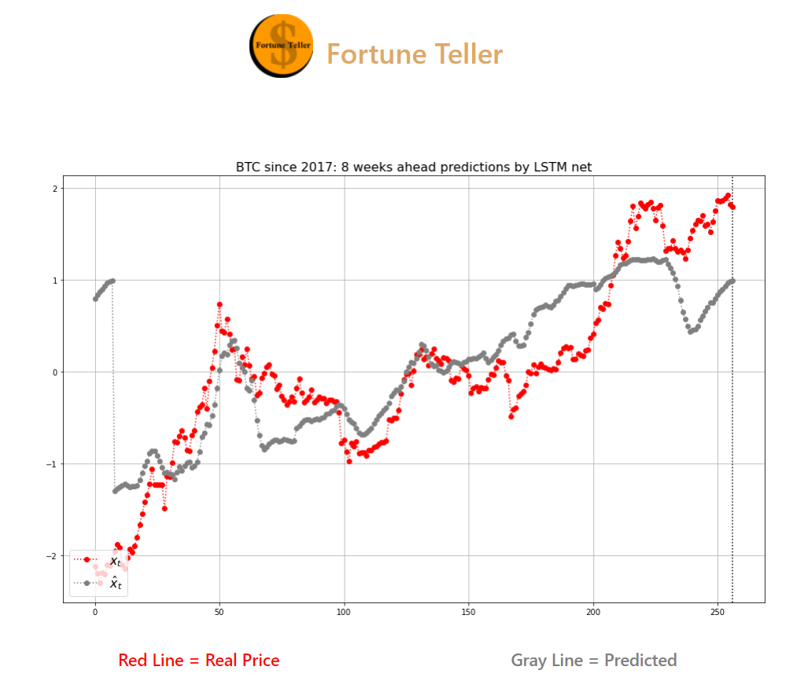
Near Product Vision
Built Front End:

Slide 22

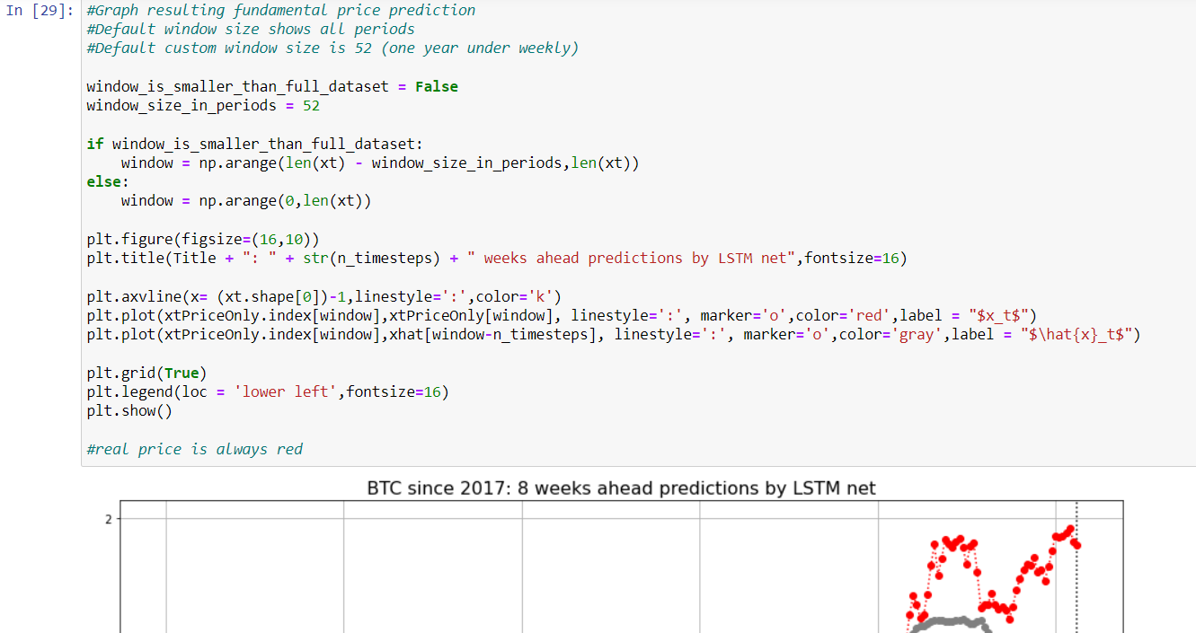
Far Product Vision
Marry Back & Front End:

